Slide 1
Sweet Trackr - Baking Order Manager
By Diana Lugo - C++ Programming – Summer 2025

Slide 2
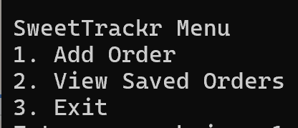
Project Overview
SweetTrackr is a C++ command-line program that allows users to add and view bakery orders. I built it for my final project because I run a home baking business, and I wanted to make something useful and personal. It helps organize customer orders and keeps a record of them using long-term file storage.

Slide 3
Program Flow
Steps:
1 | User runs the program
2 | A simple text menu appears
3 | They can add a new order or view saved orders
4 | Orders are saved automatically in a text file
5 | Program loops until the user exits

Slide 4
Data Structures Used
Vector
Order
File I/O
A vector stores multiple orders during the session
A class called Order stores customer name, date, item, and quantity
File I/O (ofstream, ifstream) is used to write/read orders from orders.txt

Slide 5
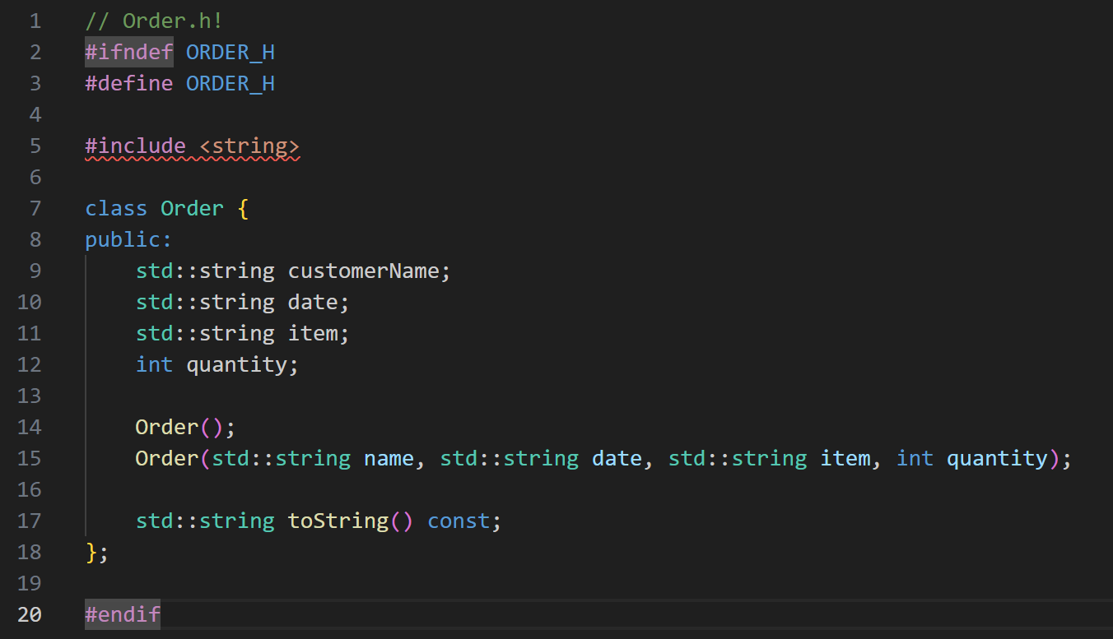
Order Class:
386,000 km
The Sun’s mass compared to Earth’s
Distance between Earth and the Moon

Slide 6
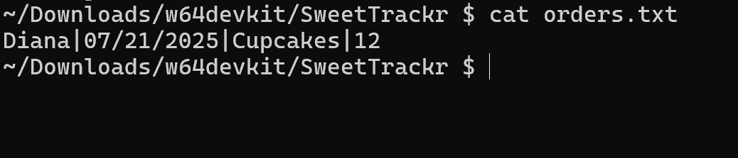
Saving Orders to File
Orders are saved to a file called orders.txt
Each time the user adds an order, it is immediately written to the file
File is opened in append mode so older orders aren’t erased
Data is saved in a simple, readable format using | as separators

Slide 7
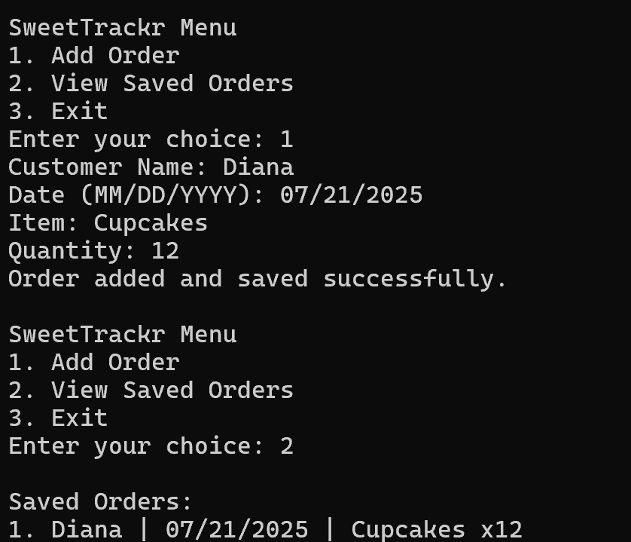
Program Demo
The program allows the user to add an order, which gets saved to a file.
When “View Saved Orders” is selected, the program reads from the file and displays all saved entries.
This confirms the data is being stored and retrieved correctly!

Slide 8
Conclusion & Reflection
This project really helped me bring together everything I’ve learned so far. I built a fully working order tracker using C++, where I got to apply object-oriented programming by creating a custom Order class and used file handling to store and load saved data. It was definitely challenging at times, especially when debugging, but seeing everything come together in the terminal felt really rewarding. I also gained a better understanding of how everyday programs, like inventory systems or simple business tools, manage long-term data storage. Overall, I feel way more confident in my ability to build and explain a complete application from start to finish. Not to mention, it was about a topic I love!

